Slide 1


Data Privacy Workshop by DE-Data Privacy Protection Cap Centre (DPPCC) Part 1 – Introductory Session 26 Jan 2022 Alan Tang, Senior Product Manager alan_tang@tech.gov.sg

Slide 2
Overview – Data Privacy Workshop
Introduction (2 – 3pm)
What is data privacy?
Privacy landscape in Singapore
PP-Tech Overview
Tea Break (3 – 3.30pm)
Hands On Session (3.30 – 5.30pm)
Set-up tutorial
PSDSRC measures
Hashing
Partitioning
Tokenisation
K-anonymity
Generating synthetic data
Conclusion

Slide 3



DPPCC was set up to deepen the Government’s expertise in data privacy protection technologies.
Develop the Government’s capabilities in data privacy protection tech solutions – both within the Centre and in Agencies.
Implement Whole-of-Government data privacy protection solutions to preserve the privacy interest of individuals while enabling the wider use of data.
Provide consultancy services to agencies that face difficulty implementing data privacy protection technologies.

Slide 4
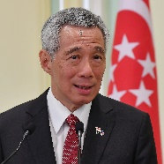

"We need to use and share data as fully as possible to provide better public services. In doing so, we must also protect the security of the data and preserve the privacy of individuals, and yet not stifle digital innovation."
”For our digital developments to go further – a foundation of trust is increasingly important…This is why Singapore will invest to build our capabilities in developing trust products and technologies.”

Slide 5
What is Data Privacy?

Slide 6
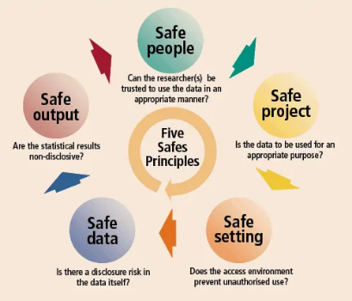
What is Data Privacy?
“Assurance that the confidentiality of, and access to, certain information about an entity is protected.”
Source: NIST SP 1800-25B
“The relationship between the collection and dissemination of data, technology, the public expectation of privacy, and the legal and political issues surrounding them.”
Source: Wikipedia

Slide 7

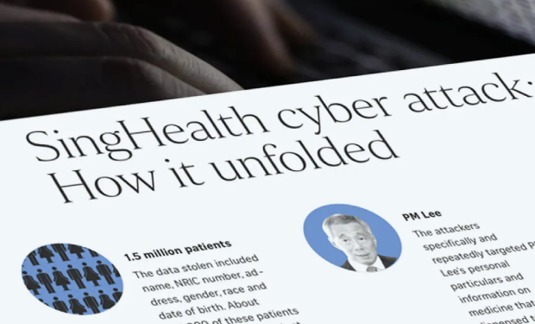
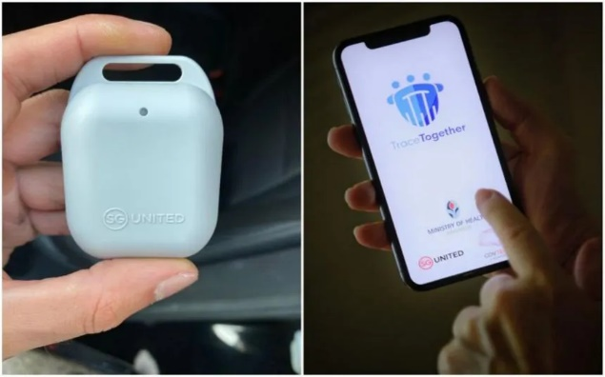
Why is Data Privacy Important?
Use and abuse of data underscores the need for privacy-preserving technologies (PP-Tech) in the public sector.
Wealth of data collected and fused by governments and Big Tech
Growing scale and sophistication of cyber-attacks, as threat actors go after large stores of personal data
Growing privacy concerns as societal awareness and norms evolve

Slide 8
“Same Same, But Different”: Data Security vs. Privacy
Data security
Data privacy
Protection and prevention of unauthorised access to data.
Protection and proper handling of sensitive information.
What?
Confidentiality, integrity and availability (CIA). Safeguard against external threats (e.g. cyber criminals).
Predictability, Manageability, Dissociability (PMD). Responsible use of data, including by authorised parties.
Focus
Example measures
Data encryption, identify access management, data loss protection.
Anonymization, differential privacy, homomorphic encryption.
Govt: IM8, RCST/Sens frameworks
Private sector: CS Act, CMA,
Int’l: ISO/IEC 27001 – 27005
Govt: IM8
Private: PDPA
Int’l: ISO/IEC 27552, GDPR, HIPAA
Regulation

Slide 9
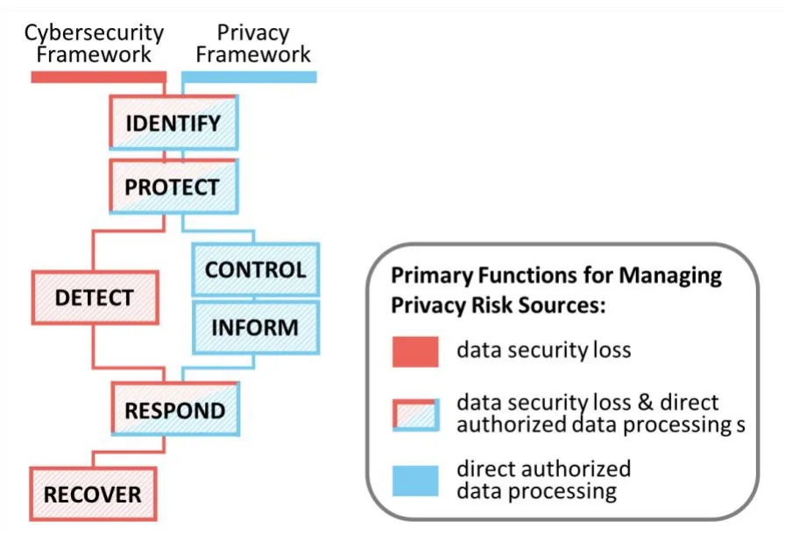
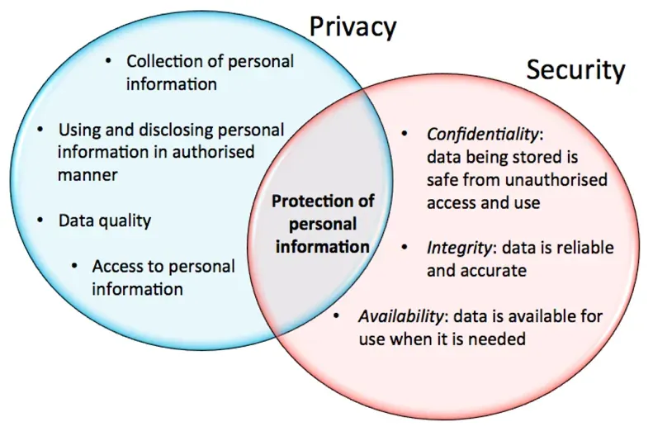
Data Security vs. Data Privacy
“Data privacy and data security are inextricably connected - while security can exist without regard for privacy, data privacy cannot exist without regard for security.”

Slide 10
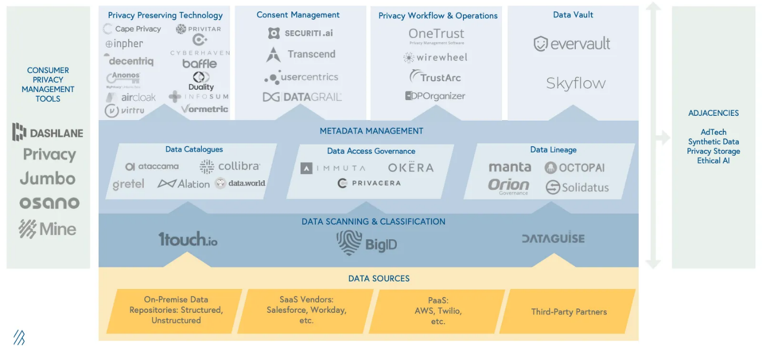
Growing PP-Tech and adjacent ecosystem as a potential area of opportunity and thought leadership for Govt.
Source: Bessemer Venture Partners

Slide 11
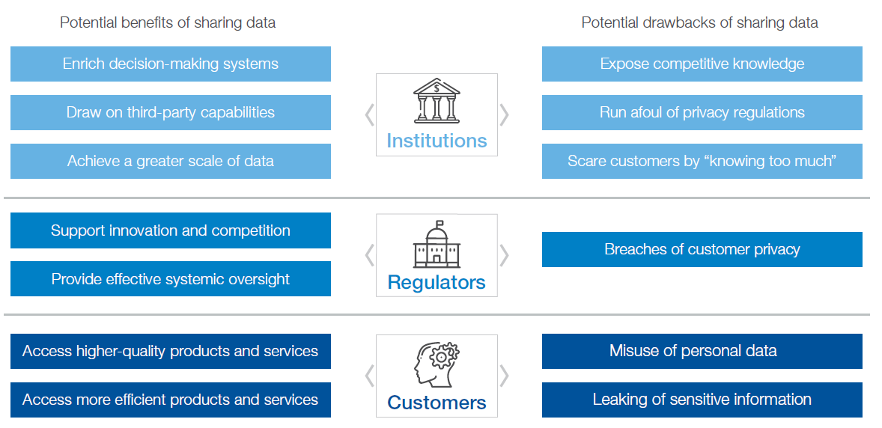
PP-Tech has potential to resolve/mitigate the risks and drawbacks of data sharing.
Source: World Bank

Slide 12
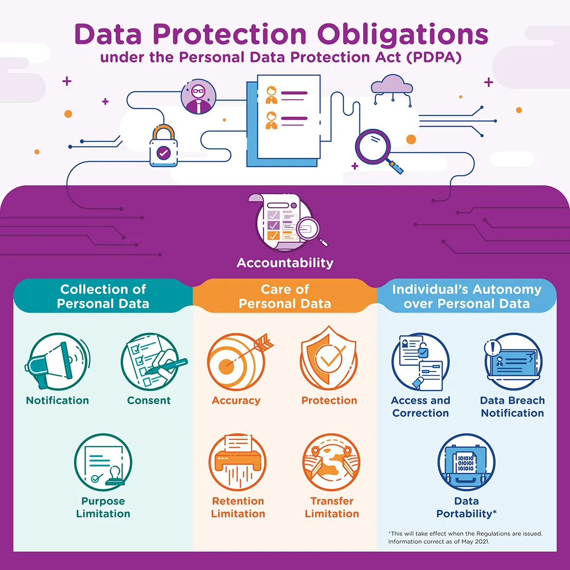

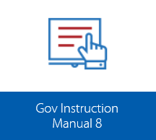
Singapore’s policy landscape is evolving; renewed interest in data privacy in public and private sector.
Data privacy measures* to be incorporated in ICT and data systems
2021 Data Protection Committee’s 13 recommendations on data protection/privacy
WOG anonymisation standards for G2NGE Sharing
Personal Data Protection Impact Assessment Framework (PDPIAF)
* E.g. Hashing with salt, field-level encryption, tokenization, data obfuscation/masking

Slide 13

Personal Data Protection Act (PDPA)
Applies to: Non-government entities, handling personal data* in both electronic and non-electronic forms.
Covers: Collection, access, correction, use and disclosure of personal data
Focuses on: High-level guidance largely pertaining to policies and processes.
Which of these obligations are most relevant to protecting the privacy of personal data?
* Personal data refers to data about an individual who can be identified from that data, or from that data and other information to which the organisation has or is likely to have access.

Slide 14
Personal Data Protection Act (PDPA)
1. Accountability Obligation
Make information about data protection policies available on request
Designate a data protection officer (DPO)
2. Notification Obligation
Notify individuals of the purposes for which your organisation is intending to collect, use or disclose their personal data.
3. Consent Obligation
Only collect, use or disclose personal data for purposes which an individual has given his/her consent to.
Allow the individual to withdraw consent, and inform him/her of the likely consequences of withdrawal.
Once consent is withdrawn, make sure that you cease to collect, use or disclose the individual’s personal data.
4. Purpose Limitation Obligation
Only collect, use or disclose personal data for the purposes that a reasonable person would consider appropriate.

Slide 15
Personal Data Protection Act (PDPA)
5. Accuracy Obligation
Make reasonable effort to ensure that the personal data collected is accurate and complete.
6. Protection Obligation
Make reasonable security arrangements to protect the personal data in your organisation’s possession.
7. Retention Limitation Obligation
Cease retention of personal data or dispose of it in a proper manner when it is no longer needed for any business or legal purpose.
8. Transfer Limitation Obligation
Transfer personal data to another country only according to the requirements prescribed under the regulations
Ensure that the standard of protection is comparable to the protection under the PDPA, unless exempted by the PDPC.

Slide 16
Personal Data Protection Act (PDPA)
9. Access and Correction Obligation
Provide individuals with access to their personal data as well as information about how the data was used or disclosed
Correct any error or omission in an individual’s personal data as soon as practicable
10. Data Breach Notification Obligation
If the data breach likely results in significant harm to individuals, and/or are of significant scale, organisations are required to notify the PDPC and the affected individuals as soon as practicable.
11. Data Portability Obligation
Transmit the individual’s data that is in the organisation’s possession or under its control, to another organisation in a commonly used machine-readable format.

Slide 17
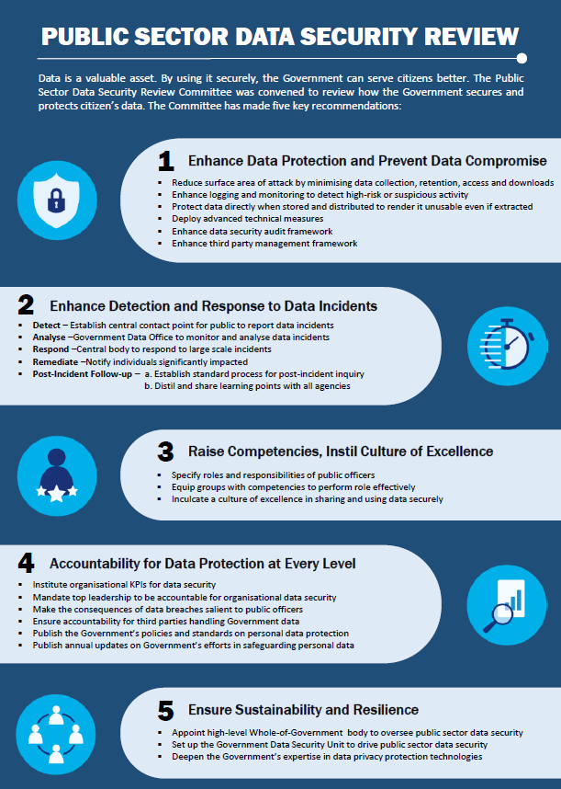
Public Service Data Security Review Committee (PSDSRC)
Report on Data Security Practices in across entire Public Service, in light of data-related incidents
Recommendations embedded into IM8, and data classification (i.e. RCST / Sensitive) frameworks
Includes 13 technical safeguards (prefixed with ‘T’) and 10 process safeguards (prefixed with ‘P’)
Measures span across data life cycle, and encompass data security and data privacy

Slide 18
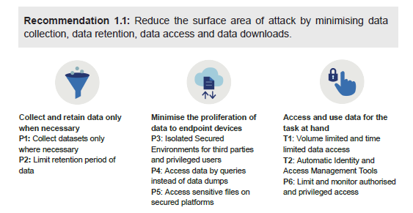
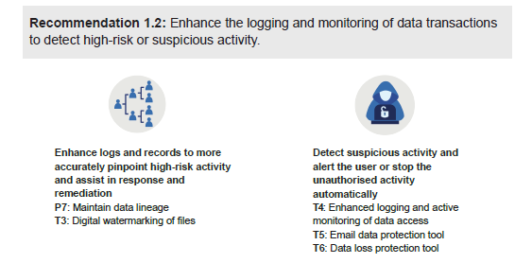
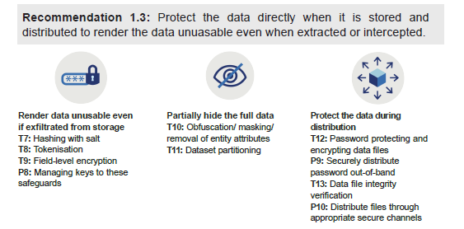
PSDSRC 10 Process
+ 13 Technical Measures
To be covered in Hands On Session

Slide 19
For internal sharing only – do not circulate
Coming soon: WOG Anonymization Framework for Public-Private Data Sharing (by Mar 22)
Mode A – Safe for public access
Mode B – Conditional and restrict access
Personal Identifiable Data
Data Access Modes with
different anonymization approach
and data utility level
Mode A (heavy anonymization, light governance)
Mode B (light anonymization, heavy governance)
Stage 1:
Prescribing Anonymization Treatments
For Different Data Access Modes
Exceptions approved by GDO
Heavy Anonymization
Light Anonymisation / De-identification
Further anonymization required
Waiver of
Anonymization Rules
Stage 2:
Testing of Re-identification Risks
Required
Optional
Non-Personal Identifiable Data
Source: SNDGO

Slide 20
For internal sharing only – do not circulate
Stage 1: WOG Standardized Treatment
We propose to:
Prescribe rules for direct and strong indirect identifiers under each access mode;
These are broadly aligned to MOH’s DAFAA and US HIPAA standards.
Suggest guidelines for weak indirect identifiers and sensitive attributes, as well as anonymisation methods, so agencies can assess the need for further anonymisation.
We will not prescribe standards for such identifiers to allow agencies greater flexibility to customize the treatment to the specific dataset.
Suggest additional guidelines to prevent possible fusion with existing publicly available datasets.
We will not prescribe standards for such identifiers, as such disclosure scenarios is unique to each dataset.
Type of Variable |  | Examples | WOG Access Mode A | WOG Access Mode B
Identifiers | Direct identifiers (i.e. uniquely identifiable variables) | Name, NRIC | Prescribed rules [Note: We plan to expand these rules further, over time.] | Prescribed rules
 | Strong indirect identifiers (i.e. can easily narrow down and identify individual) | Zipcode | Prescribed rules [Note: We plan to expand these rules further, over time.] | Prescribed rules
 | Weak indirect identifiers | Sex (2 categories), Occupation (multiple categories), Age | Suggest guidelines and recommend anonymization methods | No specific requirement or recommendations
Sensitive Attributes | Sensitive Attributes (i.e. confidential information whose disclosure is harmful) | Disease contracted | Suggest guidelines and recommend anonymization methods | No specific requirement or recommendations
Source: SNDGO

Slide 21
For internal sharing only – do not circulate
Stage 1: Proposed Prescribed Rules for Direct and Strong Indirect Identifiers
S/N | Data Field | WOG Access Mode A | WOG Access Mode B
Direct Identifiers
1 | Name | Removal | Removal
2 | NRIC / FIN | Pseudonymisation | Pseudonymisation
3 | Any photographs, biometric identifiers | Removal | Removal
4 | Contact number, email address | Removal | Removal
5 | Any account numbers and identifying numbers that are unique (e.g. insurance plan numbers or bank account numbers) | Removal | Replace with episodic registration number
6 | All other direct identifiers | Removal | Removal
Strong Indirect Identifiers
7 | Structured Address and Zip Code | Removal of address Retain initial 3 digits of zipcode | Removal of address Retain initial 3 digits for landed properties Retain in full for multi-unit properties, e.g. HDB blocks
8 | Date of Birth and other elements of dates that are directly related to an individual (e.g. NRIC issue date) | Removal | Retain month and year
9 | URLs, IP address | Removal | Removal
10 | Vehicle identifiers | Removal | Removal
11 | Unique occupations (e.g. President) | Removal or aggregate | Aggregate
12 | All other strong indirect identifiers | Removal or generalisation | Removal or generalisation
Source: SNDGO

Slide 22
For internal sharing only – do not circulate
Stage 1: Proposed Guidelines for Strong Indirect Identifiers
and Sensitive Attributes
S/N | Data Field | WOG Access Mode A | WOG Access Mode B
Weak Indirect Identifiers
1 | All weak indirect identifiers | Agencies should assess whether there is a need to anonymise weak direct identifiers. As a general guide, the lesser the number of categories, the lighter the treatment required (see recommended anonymization methods). | N.A., retain full
Sensitive Attributes
2 | All sensitive attributes | Agencies should assess whether a data field is a sensitive attribute. Where datasets have sensitive attributes, agencies should assess (a) the sensitivity of these attributes; and (b) the risk of misuse of such data from re-identification, in order to determine whether anonymisation methods should be applied. Agencies should also consider other additional safeguards (e.g. such as pre-screening of researchers), should more sensitive attributes be shared as part of the dataset. | N.A., retain full
Source: SNDGO

Slide 23
For internal sharing only – do not circulate
Stage 2: Testing of Re-Identification Risks
To ensure that the datasets are ‘sufficiently anonymised’ and the re-identification risks are sufficiently low, we propose to:
Introduce two mandatory re-identification risk tests for WOG Access Mode A; and
Suggest optional re-identification risk tests otherwise.
Re-Identification Test | Details | WOG Access Mode A | WOG Access Mode B
K-Anonymity Test | Used to confirm that the anonymisation measures put in place achieve desired threshold against linking test [Note: Thresholds aligned to Australia’s De-identification Decision-Making Framework.] | Required (Minimally k-anonymous at k=5) | Optional (Minimally k-anonymous at k=3)
Motivated Intruder Test | Used to help identify gaps in anonymization (see Annex A for details) | Required | Optional
Other Re-Identification Tests | Other tests include l-diversity and t-closeness tests, which are more complicated re-identification measures (to be developed further) | Optional | Optional
To be covered in Hands On Session
Source: SNDGO

Slide 24
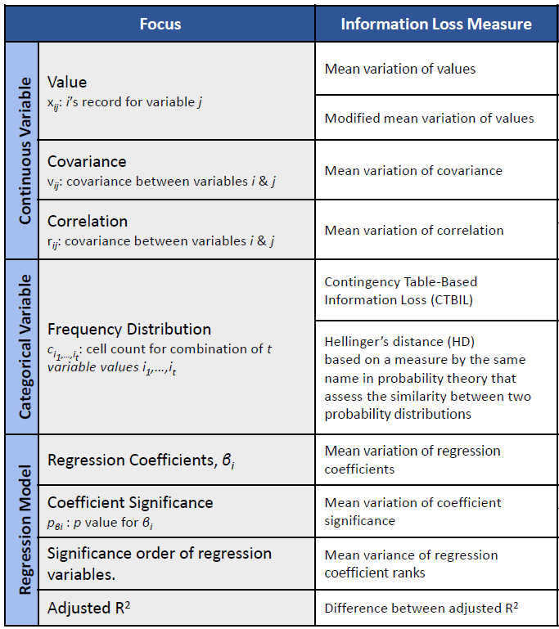
For internal sharing only – do not circulate
Assessment of Data Utility
To better balance re-identification risk with loss in utility of the dataset, we recommend for agencies to consider measuring loss in data utility following anonymisation. For reference, DOS’s Microdata Anonymisation Framework outlines the measure for assessing data utility loss, which agencies may consider adopting.
In gist, the information loss measures cover the following areas:
Continuous Variables. To account for the “difference” between the statistical estimates from the original dataset and the anonymised dataset, e.g. record value, variable mean, variable total, variable variance, covariance, and correlation.
Categorical Variables. Measured by comparing the frequencies in the contingency tables generated by the original dataset and anonymized dataset. If suppression is introduced during the anonymisation step, information loss for categorical variables can be as simple as counting the total number of suppressions performed on the microdata file.
Regression Models. Measured by the changes in estimated regression coefficients, significances, and goodness of fit such as Adjusted R-squared after anonymisation.
Extracted from DOS’s Microdata Anonymisation Concepts and Techniques
Source: SNDGO

Slide 25

DE-DPPCC is developing a one-stop, self-service Central Privacy Toolkit will help agencies to (a) adopt WOG anonymisation framework, and (b) test drive more advanced PP-Tech.
For illustration
Original
Dataset
Anonymized
Dataset
1
2
3
Identify
Transform
Review
Select ruleset (e.g. IM8)
Apply custom rules
Compare input vs output
Upload and parse dataset(s)
Review privacy risk score
(e.g. k-anonymity)
Select fields
Anonymization (e.g. Hashing, masking, pseudonymisation)
Review utility score (e.g. information loss)
Review metadata summary
PSDSRC Measures (e.g. hashing, dataset partitioning)
Accept/reject output
Define anonymization parameters
Differentially private noise injection
Transform Dataset
Export Anonymized Data

Slide 26
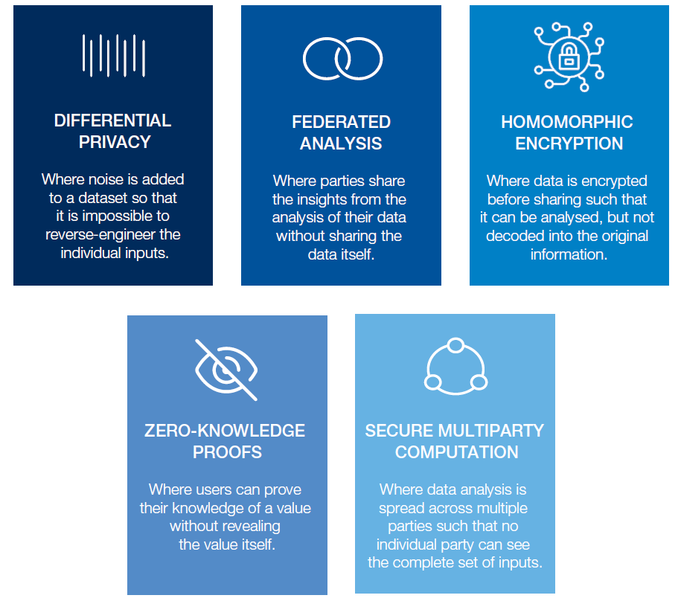

Overview of Key Privacy-Preserving Technologies
DATA ANONYMIZATION
Where personally identifiable information is encrypted or removed from data sets.
Cited as examples in 2019 PSDSRC Report

Slide 27
Overview of Privacy-Preserving Technologies*
*Based on 2021 landscape study
Data anonymization
Federated Learning
Differential Privacy
Impact
Homomorphic Encryption
Synthetic Data Generation
Secure Multi-Party Computation
Zero-Knowledge Proof
Maturity

Slide 28
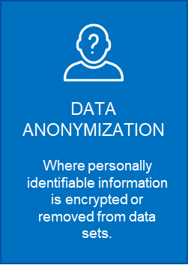
Definitions
De-identification
Remove any identifiers (e.g. names, address, NRIC)
Anonymisation
Remove identifiers, remove/alter information, or collapse detail, to ensure that no person or organisation is likely to be identified in the data (either directly or indirectly).
Techniques can be….
Non-perturbative: reduce the detail in the data by generalization or suppression of certain values without distorting the data structure.
Perturbative methods do not suppress values in the dataset but perturb (i.e., alter) values to limit disclosure risk by creating uncertainty around the true values.
Probabilistic: Depend on a probability mechanism or a random number-generating mechanism. Every time a probabilistic method is used, a different outcome is generated.
Deterministic: Follow a certain algorithm and produce the same results if applied repeatedly to the same data.

Slide 29
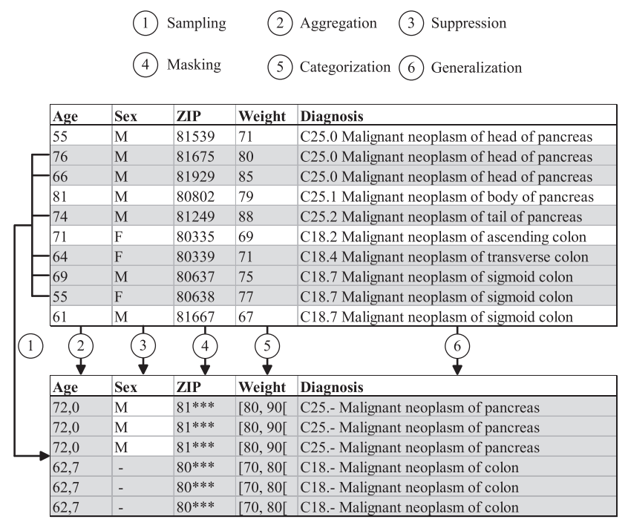
Examples

Slide 30
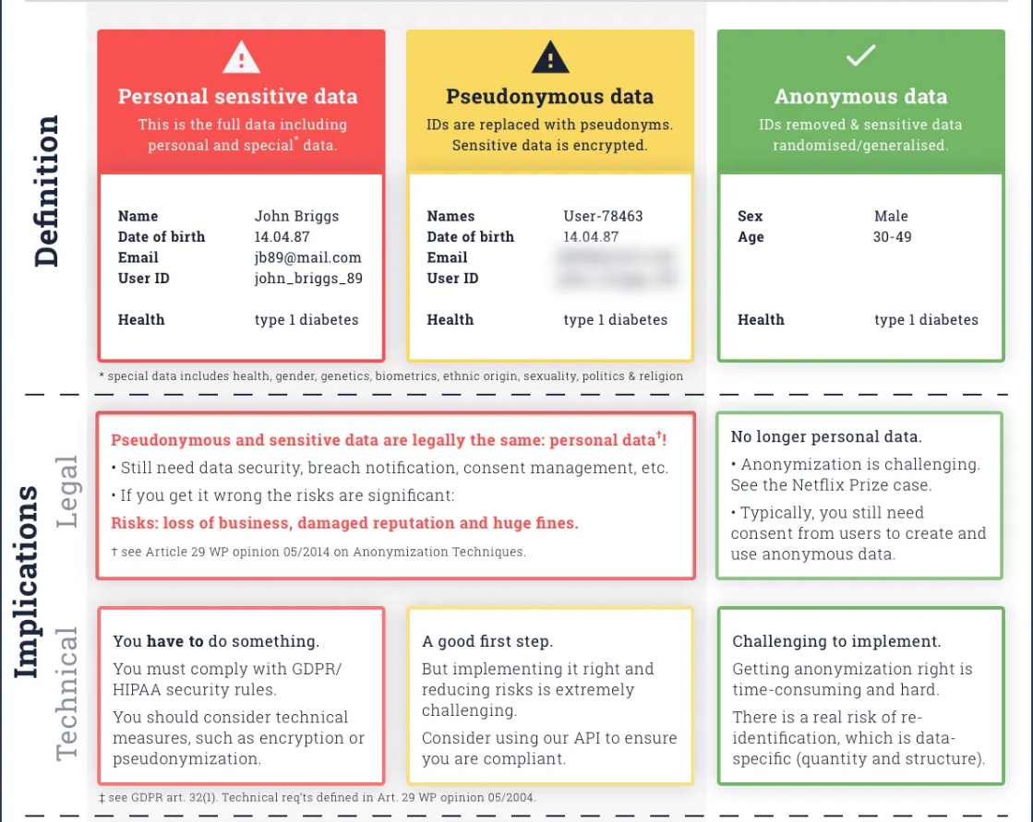
Data anonymization techniques can be applied to varying degrees…

Slide 31
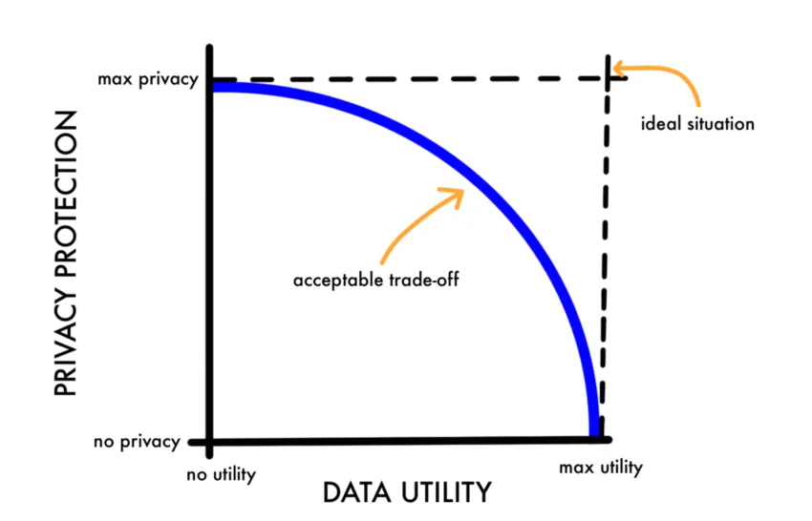
…. but there is always a trade-off between privacy vs utility.

Slide 32
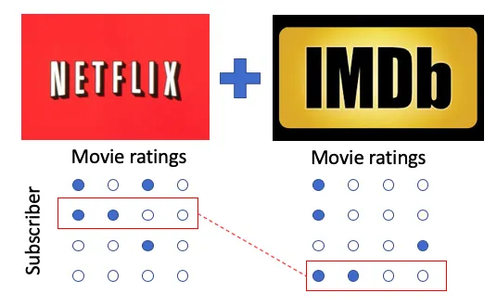
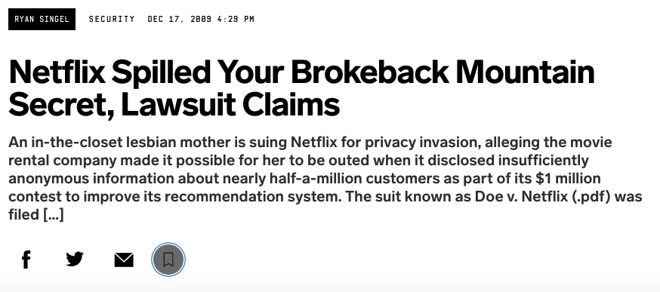
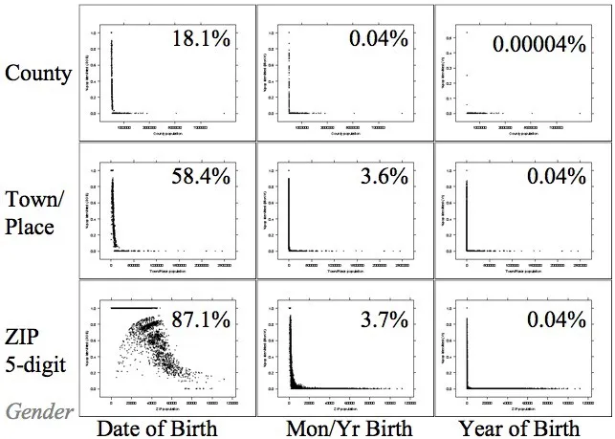

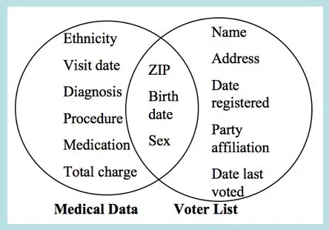
Simple anonymization alone is insufficient
87% of individuals in the U.S. can be uniquely identified alone by knowing 3 pieces of information: gender, date of birth, and zip code.
Notes:
Netflix published 10 million movie rankings by 500,000 customers, as part of a challenge for people to come up with better recommendation systems than the one the company was using. The data was anonymized by removing personal details and replacing names with random numbers, to protect the privacy of the recommenders. Arvind Narayanan and Vitaly Shmatikov, researchers at the University of Texas at Austin, de-anonymized some of the Netflix data by comparing rankings and timestamps with public information in IMDb. It turns out that if you eliminate the top 100 movies everyone watches, our movie-watching habits are all pretty individual. This would certainly hold true for our book reading habits, our internet shopping habits, our telephone habits and our web searching habits.
In 1996, a Ph.D. student at MIT called Latanya Sweeney combined publicly released and anonymous medical data released by the Group Insurance Company (GIC) with public voter records (which she purchased for $20) and was able to reidentify Massachusetts governor William Weld from the dataset.
This paper concludes that 87% of individuals in the U.S. can be uniquely identified alone by knowing 3 pieces of information: gender, date of birth, and zip code.About half of the U.S. population (132 million of 248 million or 53%) are likely to be uniquely identified by only {place, gender, date of birth}, where place is basically the city, town, or municipality in which the person resides

Slide 33
Overview
Pros:
Able to generalize and implement at scale
“Low hanging fruit” that unlocks new use cases
Large variety of techniques available
Cons:
Potential reidentification risk e.g. through correlation to other datasets
Information loss undermines analysis
Use Cases:
“De-risk” datasets for sharing, publication and retention (under GDPR, anonymized data is not personal data)

Slide 34
Definition
Differential privacy is a mathematical technique of adding a controlled amount of randomness to a dataset to prevent anyone from obtaining information about individuals in the dataset.
Differential privacy introduces a privacy loss parameter, often denoted as epsilon (ε), to the dataset. ε controls how much noise or randomness is added to the raw dataset.
Flow diagram of Differential Privacy algorithm
Suppose you have a column in your dataset with “Yes”/”No” answers from individuals. For each individual:
Flip a coin.
If heads, return the answer in the entry.
If tails, then flip a second coin and return “yes” if heads and “no” if tails.
This process adds randomness to data. Now, each person is protected with “plausible deniability”, because a person is plausible to deny the answer by the randomness of flipping a coin. For large enough data and with the information of the noise-adding mechanism, the dataset is still accurate in terms of aggregate measurements.

Slide 35
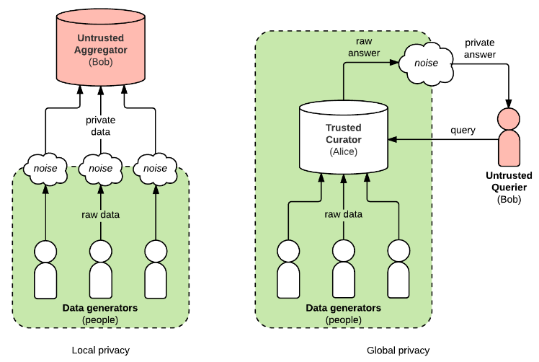
Example
Achieving “ϵ”:
Global:
In a globally private system, one trusted party (or curator) has access to raw, private data from lots of different people. The curator does analysis on the raw data and adds noise to answers after the fact.
Local:
With local privacy, there is no trusted party; each person is responsible for adding noise to their own data before they share it.

Slide 36
Overview
Pros:
Statistically measure privacy ‘leakage’
Computationally inexpensive
Fairly mature concept with multiple industry use cases
Cons:
Adding noise directly creates a trade-off between precision and privacy
Best-suited to evaluating general trends, rather than anomaly detection (e.g. fraud analysis) or accurate pattern-matching (e.g. optical character recognition).
Use Cases:
Enable sharing of datasets without infringing on individual privacy (e.g. US Federal Census, Apple autocomplete, Google COVID-19 Community Mobility Reports)

Slide 37
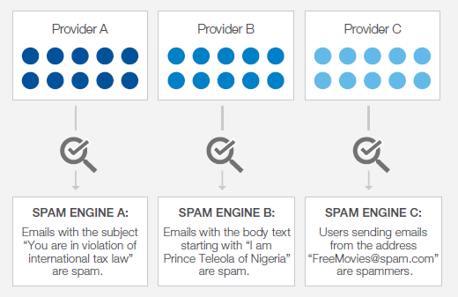
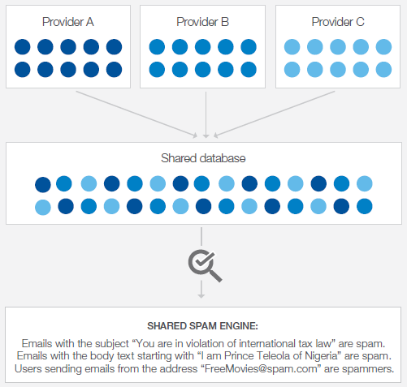
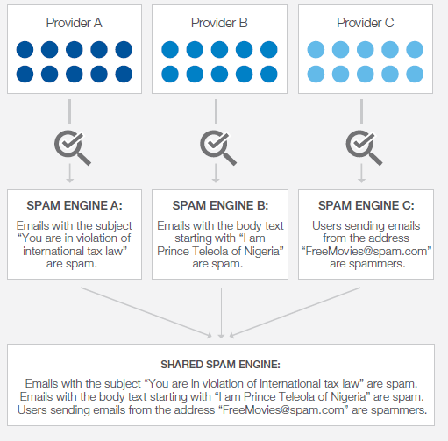
Federated Analysis/Learning – Illustration
Individual databases
Central database
Individual databases
with federated analysis

Slide 38
Pros:
Minimizes communication costs
Protects sensitive data within original source – share insights without sharing data
Cons:
Complexity of distributed systems
Requires scale – isolated datasets need to provide meaningful insights.
Use Cases:
Cases whereby data is locked (e.g. legislatively)
Enable machine learning models from non-co-located data.

Slide 39
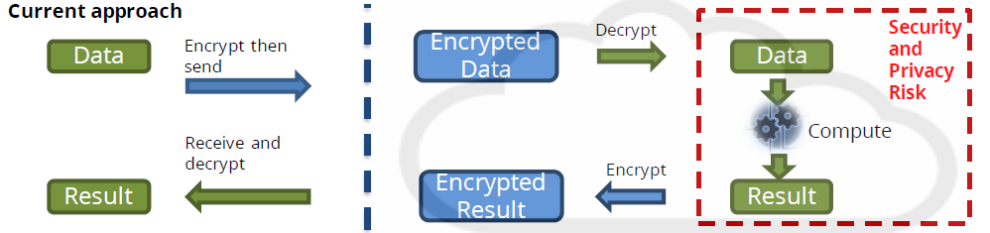
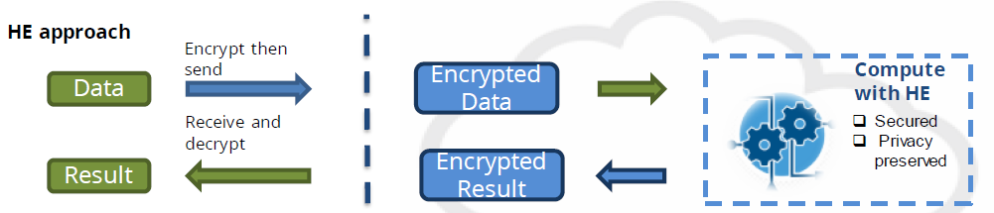
Homomorphic encryption allows computation of data without the need to decrypt it.

Slide 40
Pros:
Resilient to data breaches
Cons:
Computationally demanding
Limited operations (e.g. addition / multiplication)
Does not free orgs from privacy obligations
Use Cases:
Third party has capabilities the data steward does not, and the third party wishes to provide their analytics as a service without sharing the underlying functions they are using
Third party has access to other, complementary data that the data steward does not have, and as a result is able to provide better analytics and insights than the steward could do independently.

Slide 41
Recap: Potential benefits of PP-Tech
1
2
Improve Data Sharing by “de-risking” datasets for sharing within Government, and/or the private sector
Unlock new use cases that would otherwise be impossible to capture due to concerns / regulations.
3
4
Enable protection of data throughout data lifecycle; reduce impact of data breaches.
Increase public trust, confidence
and adoption of Smart Nation.
“How might we leverage privacy-preserving technologies to unlock new use cases for data in the public sector, while upholding public trust in Smart Nation?”

Slide 42
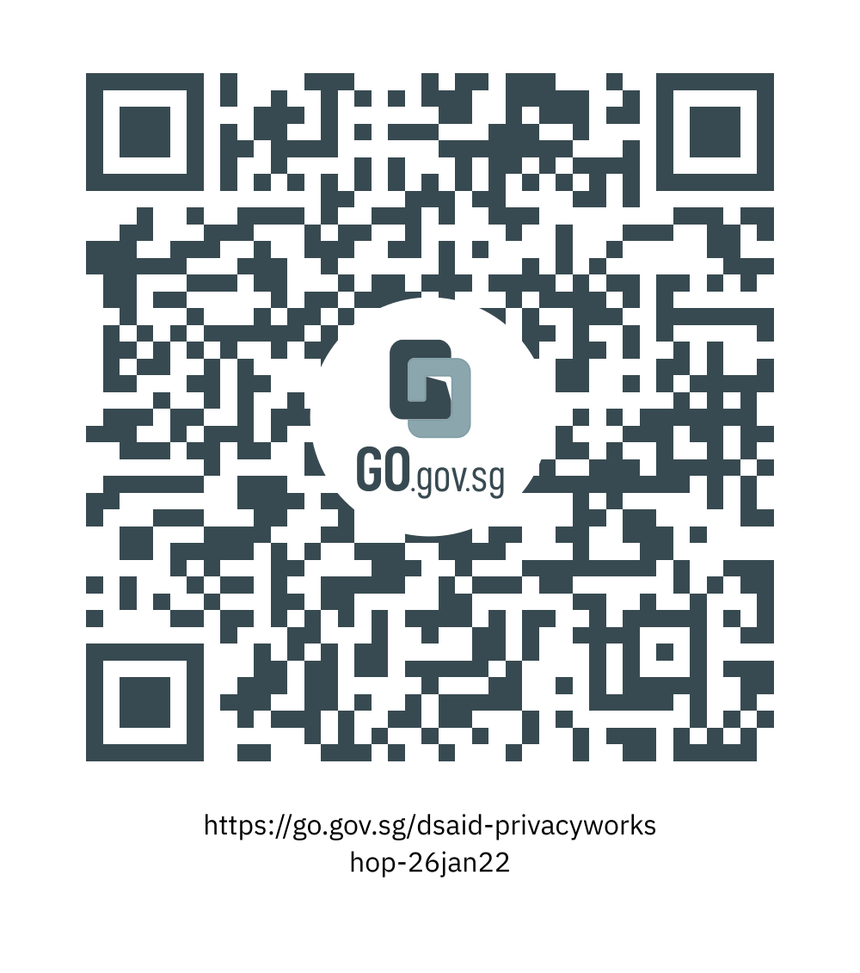
See you at 3.30pm!
To set up, head over to:
https://github.com/dsaidgovsg/data-privacy-workshop

Slide 43
Thank you
Let’s collaborate!
alan_tang@tech.gov.sg

Slide 44
Links and resources
Introduction to PP-Tech:
Privacy Preserving Techniques Handbook UN Global Platform (officialstatistics.org)
The Next Generation of Data-Sharing in Financial Services: Using Privacy Enhancing Techniques to Unlock New Value | World Economic Forum (weforum.org)
More on data anonymization:
PDPC Guide to Basic Data Anonymization
Regulation:
PDPC website: https://www.pdpc.gov.sg/Overview-of-PDPA/The-Legislation/Personal-Data-Protection-Act
PSDSRC 2019 Report: https://www.smartnation.gov.sg/files/publications/psdsrc-main-report-Nov2019.pdf
IM8 (GSIB Intranet): https://intranet.mof.gov.sg/portal/IM/Themes/IT-Management/Data.aspx

